Slide 1


DEPARTMENT OF ELECTRICAL AND ELECTRONICS ENGINEERING
18EEP302L – MINOR PROJECT IV
Second Review
TOPIC: PHASE OUTAGE INTIMATION IN THREE PHASE SYSTEM
Batch no : 02
Batch Members
Bhoopesh T (20BEE4006)
Dharunish A P (20BEE4015)
Deenadhayalan M (20BEE4304)
Guided by
Dr C Kumar
Professor /EEE
MKCE

Slide 2
Overview of Presentation
Abstract
Introduction
Literature survey
Existing Block Diagram
Proposed Block Diagram
Circuit Diagram
Components and its Specification and Cost
Hardware Setup
Results and Discussion
Conclusion
List of Publications

Slide 3
Abstract
The main idea of our project is to intimate the power conversion from three phase to single phase conversion which routinely happens in the agricultural areas actually our project function as a phase outage intimation system.
There are some industries which was located in agricultural areas to operate their machines in two phase supply, they are using inverter but especially in textile industry, they use compressor for cleaning purposes which will operate only in three phase supply, hence by intimating whether the supply was three phase or single phase through their android devices, it will help them to do their work efficiently.
The Compressor's operating time was one to two hours only for a day and hence they (the textile industry persons) don't show interest in replacing inverters with the compressor by considering the cost.
Key Words: Phase Outage Intimation System, Textile Industry, Compressor.

Slide 4
Introduction
In the agricultural areas to maintain the power demand or power required the electricity board will follow the timings as eight hours three phase and remaining hours as two phase including the peak hours.
To intimate exact power conversion timing, our project was extremely helpful because it will send a message to the android device when power conversion takes place.
Additionally we are using current transformers and voltage transformers for measuring the current and voltage values which flows through each phases as a result it helps in detecting the fault analysis in three phase supply system.
And in future, we are planned to make the units consumed calculations by the three phase load and the values will be monitored using android devices

Slide 5
Literature Survey
S.NO | TITLE | AUTHOR | YEAR | DESCRIPTION
1. | Phase Failure Detector and Their Significance in Power System Engineering | L.S. Ezema B.U. Peter O.O. Harris Electrical Power and Electronic Development Department, Projects Development Institute(PRODA), Enugu, NIGERIA. | 2012 | Electrical power system engineering comprises power generation, transmission, distribution, and the utilization of electricity. Modern trends in the development of electric power systems explore means of improving efficiency in these stages mentioned. On the demand side, the protection of consumer equipment and appliances from damage and total destruction due to phase failures is an issue of paramount importance mainly in parts of the world with unsteady supply of electricity. In this work we took a detailed look into what a phase failure is and the possible causes. Then we finally explain the details of a method we have developed that detects cases of phase failure and takes the appropriate measure that will save the consumer loads from the damages.

Slide 6
S.NO | TITLE | AUTHOR | YEAR | DESCRIPTION
2. | Assessment of the Impact of Line Outage in Modern Power System | Mehebub Alam Biswaranjan Mishra Siddhartha Sankar Thakur Dept. of Electrical Engineering, NIT Durgapur, Durgapur, India | 2018 | Nowadays the power system is becoming complex day by day due to increased loading. In deregulated power system, the system has to deal with the varying load under open access. This results in gradually increased power flow level leading to more and more stress on the power system. Under such stressed condition, if line outage occurs, this may cause a voltage stability problem as well as line power flow problem. So, it has become essential to study the impact of line outage in power system so that control actions can be taken accordingly by power system operators. This paper presents the impact of contingency due to line outage in a comprehensive manner. The voltage profile of buses is analysed with PV curve under contingency cases. The post contingency power flow and voltage angles are also compared with the base case. The proposed methodology has been tested for standard IEEE 5 bus, IEEE 14 bus and IEEE 30 bus system to check the various important parameters and effectiveness. However this study will be helpful for power system researchers, planners, academicians to carry out the various analysis and for decision making to maintain a reliable, secure and stable power system.

Slide 7
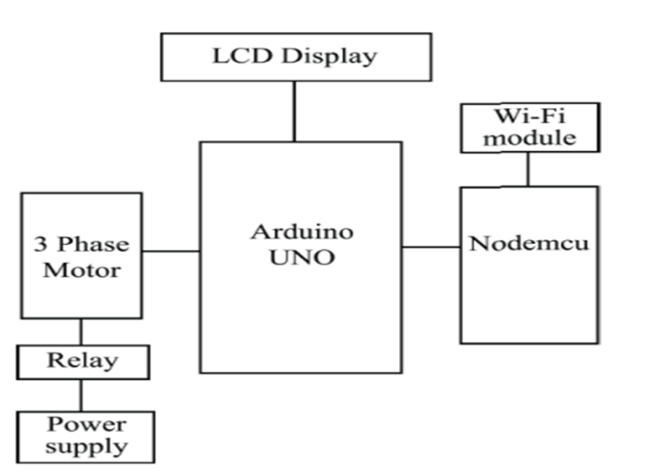
Existing Block Diagram

Slide 8
Problem Identified
The existing system has Arduino UNO (microcontroller) and Nodemcu (for communication purpose) which makes the system expensive and to reduce the cost of the system in proposed system Bluetooth module (HC 05) has been used.
In case of phase outage, existing system cut off the supply at the load side by using relay. There will be no intimation process in the existing system and hence the load has been directly connected to UNO board but in proposed system, main power source has been directly connected to the UNO board to achieve the intimation process by collecting the data (voltage value in each phase) using sensors.

Slide 9
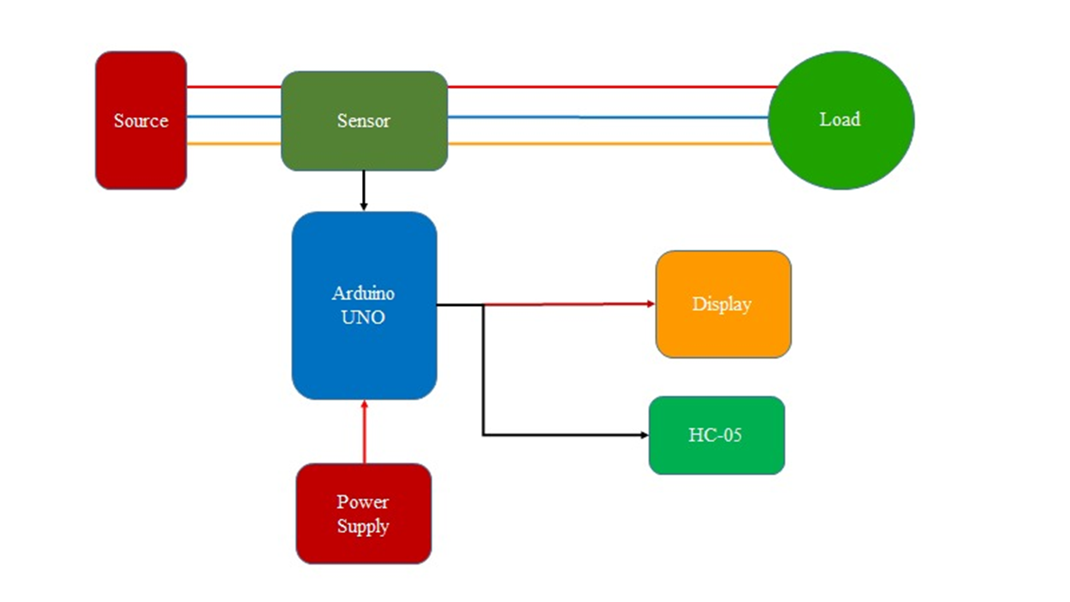
Proposed Block Diagram

Slide 10
Proposed Block Diagram Explanation
The each phase of three phase supply system is connected to the voltage sensors and then it was connected to the respective loads.
The sensors were connected to the Arduino microcontroller which will receive a signal from the voltage sensors during power conversion since it was connected to the Bluetooth module we can able to send an alert message to the respective android devices.
When any one phase doesn’t receive a minimal threshold value from the voltage sensors, it will send a signal to the microcontroller and microcontroller send signals to LCD display and the Bluetooth module for intimation which helps to know during the power conversion and faulty conditions in the three phase system.
It will cut off the power supply during the faulty conditions which will protect the load which was connected in three phase system.

Slide 11
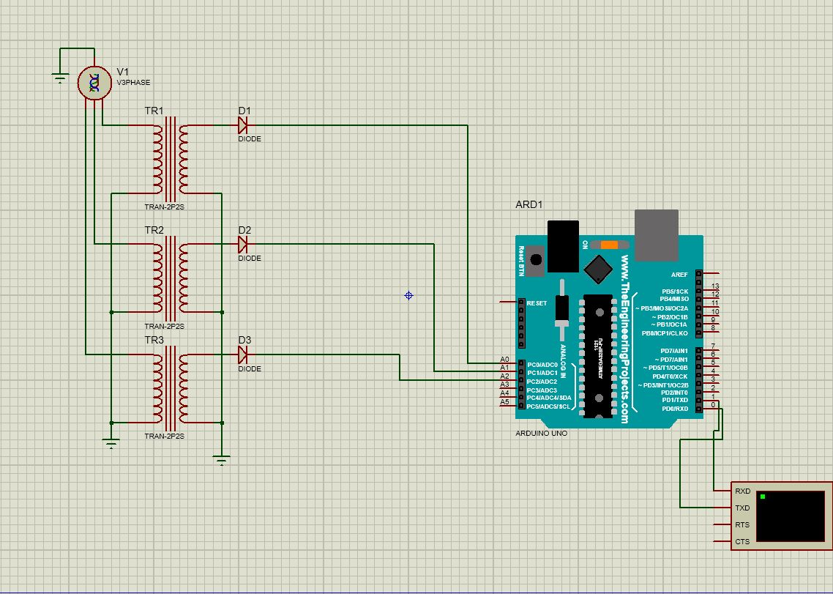
Circuit Diagram

Slide 12
Circuit Diagram Explanation
The main electrical parameters (voltage and current values) can be seen by this Virtual Terminal (acts as a Bluetooth Module) and it will display an intimation message in case of phase outage.
Virtual terminal was connected in between the Bluetooth Module and Arduino UNO (the receiver and transmitter pins of UNO was connected to the transmitter and receiver pins of Bluetooth module).
In the diagram V1(v3 phase) indicates the three phase power source and each phase was connected with transformer with star connection for measuring the voltage values at each phases.

Slide 13
Circuit diagram explanation cont…,
In order to convert the three phase alternate parameter values to equivalent direct parameter values, the diode was connected in between the transformer and the microcontroller.
The voltage values at each phase will be measured continuously by transformers (sensors) and the data should be send to the microcontroller for further processing.
In case of sudden deviation in the voltage values, the intimation message will be displayed by sending signal to the virtual terminal(Bluetooth module) with the help of microcontroller.

Slide 14
Components and its Specification and Cost
Components | Specification | Quantity | Price(₹)
Arduino | UNO | 1 | 1000
Voltage Sensors | ZMPT101B | 3 | 850
Bluetooth Module | HC - 05 | 1 | 250
LCD Display | 16 x 2 with I2C Module | 1 | 300
Power Source | 12 V DC | 1 | 100
TOTAL= Rs 2500 /- |  |  | 1500

Slide 15
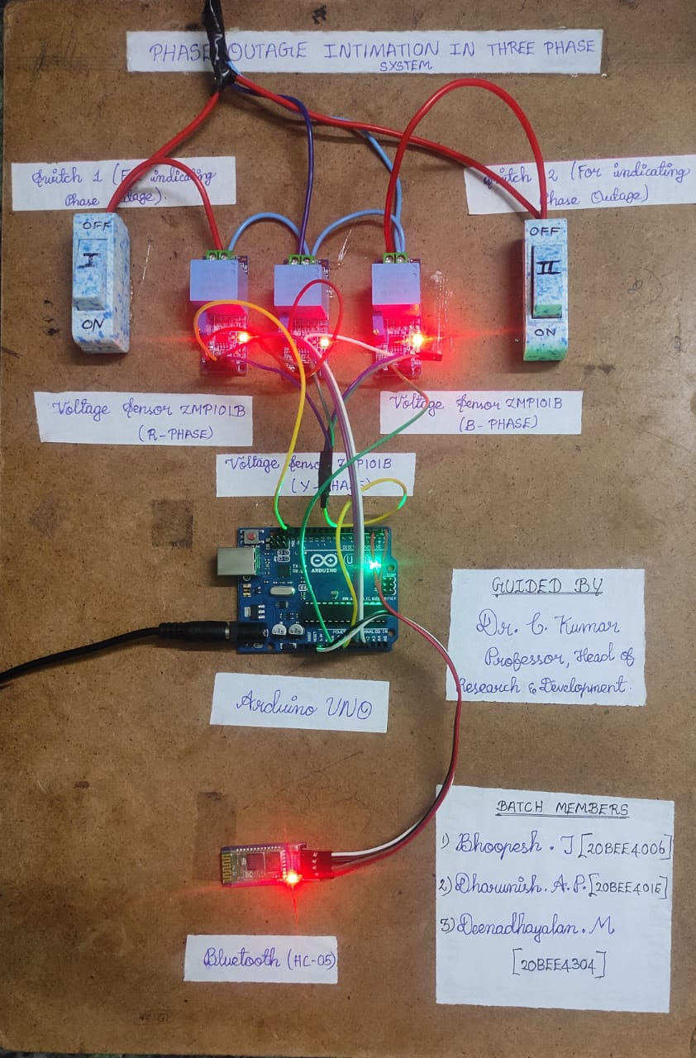
Hardware Setup

Slide 16
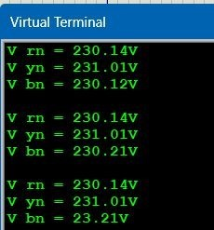
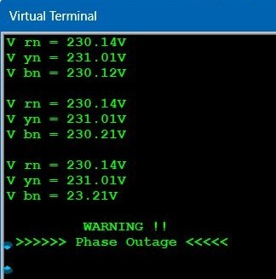
Results and Discussion
After outage
(Phase outage condition)
Before outage
(under normal condition)

Slide 17
Conclusion
The textile industry is constantly evolving, and there are several potential future scope for phase outage intimation in this industry. Here are a few possibilities:
Artificial intelligence and machine learning: The textile industry can leverage AI and machine learning to detect phase outages in real-time. AI algorithms can learn from data collected from the textile machines and power supply systems to identify patterns that indicate a phase outage. This can lead to more accurate and timely phase outage detection.
Predictive maintenance: Predictive maintenance can be used to identify potential phase outage issues before they occur. By analysing data from the textile machines and power supply systems, predictive maintenance algorithms can predict when a phase outage is likely to occur and alert the operators to take corrective measures before the outage happens.

Slide 18
Future Scope
This Phase Outage Intimation System also helps in fault detection of the machines which has been used in textile industry and in future we have planned to implement unit calculation system which leads a way to utilize the power in efficient manner.
By adding some sensors like temperature sensors, smart accumulators and weft sensors and implementing a monitoring and controlling system using IOT leads to make a smart textile industry which helps in increasing the outcome of the production.

Slide 19
References
https://ieeexplore.ieee.org/document/7328807
https://www.sciencedirect.com/science/article/pii/S0142061517310644 https://ieeexplore.ieee.org/document/5470876
https://www.sciencedirect.com/science/article/pii/S1876610215034241
https://www.degruyter.com/document/doi/10.1515/ijeeps-2014-0086/html

Slide 20
List of Publications
Dr C Kumar, A P Dharunish, T Bhoopesh, M Deenadhayalan of M. Kumarasamy College of Engineering is presented the research paper entitled “Phase Outage Intimation in Three Phase System” in the International Conference on Recent Advancements in Engineering and Technology (ICRAET'23) held at M.KUMARASAMY COLLEGE OF ENGINEERING, Karur, Tamil Nadu, India during 31st March 2023.

Slide 21
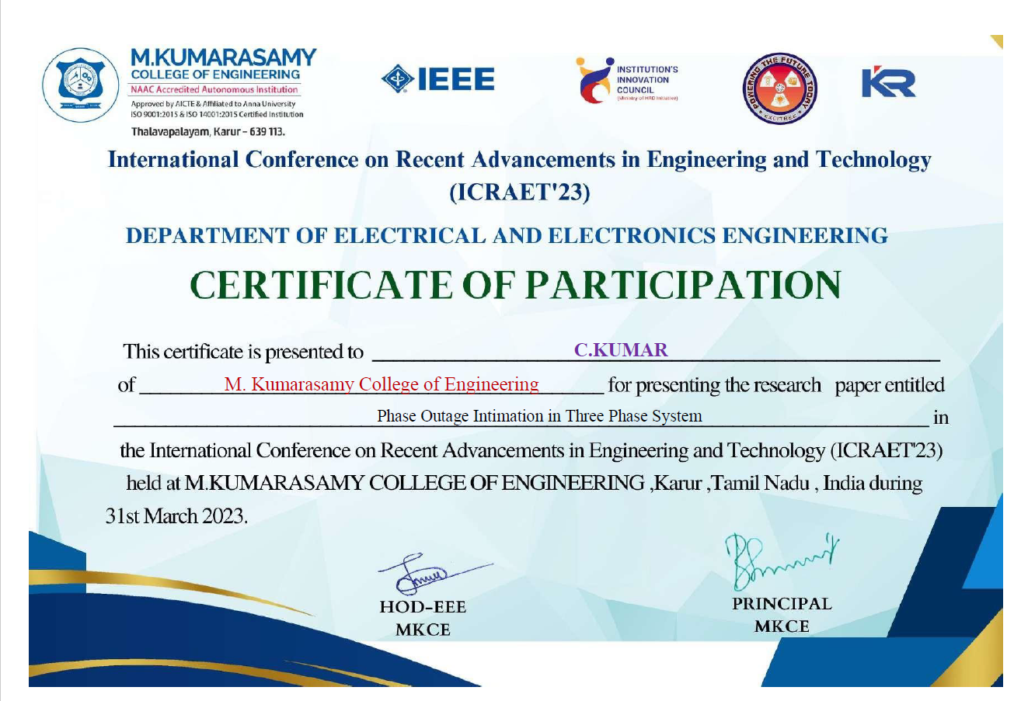
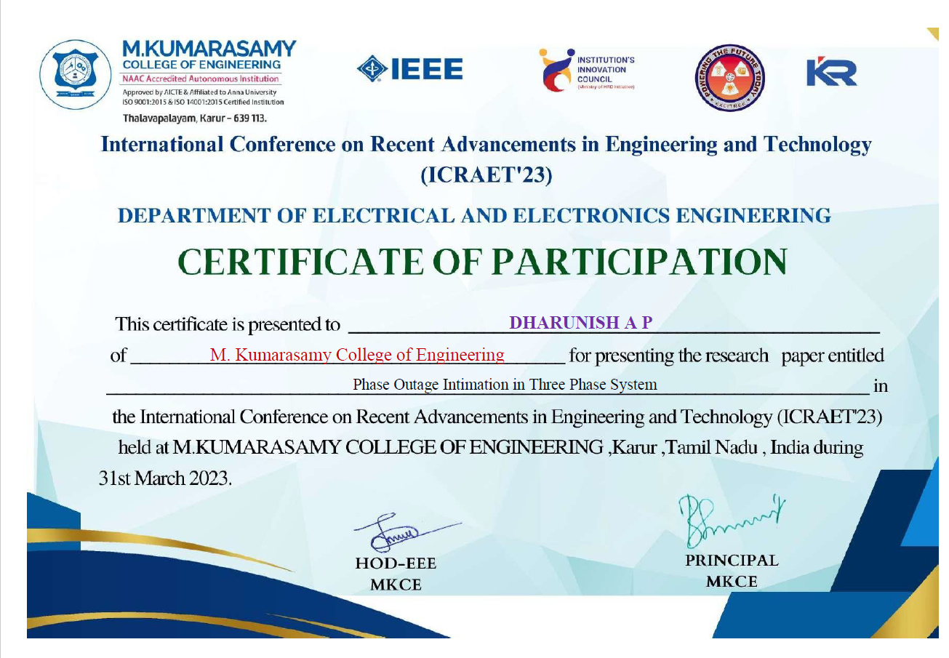
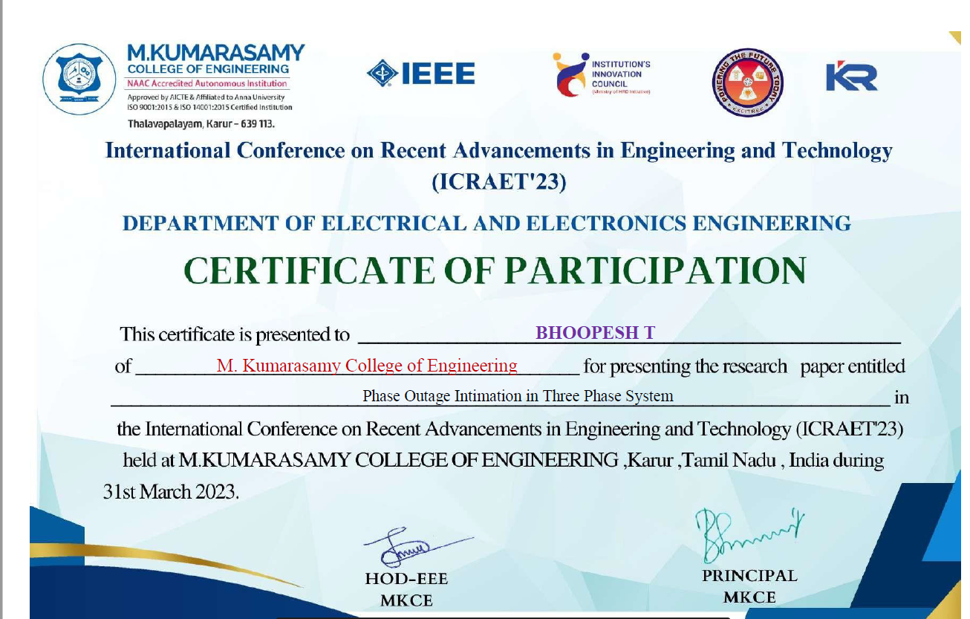
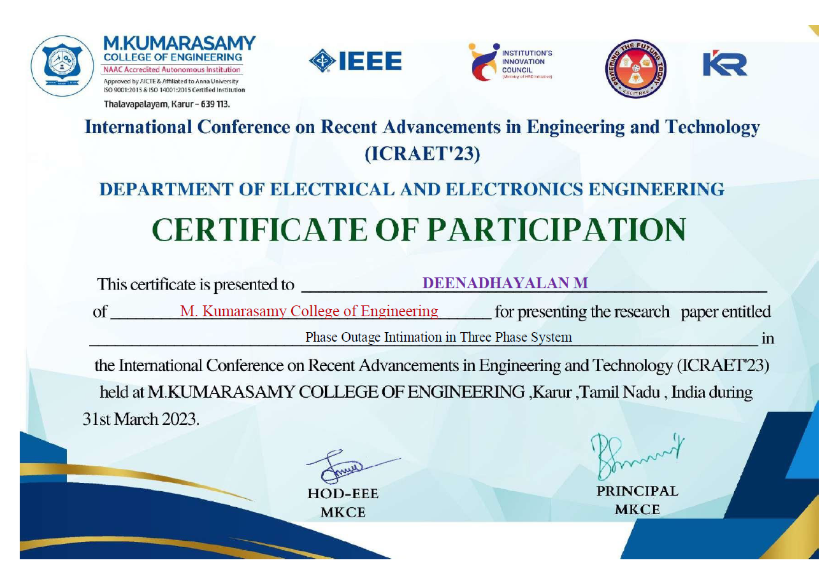

Slide 22


